Slide 1
Topic Cafeteria Management System
Submitted by
Sadia Anha Tonni (UG02-49-18-004)

Slide 2
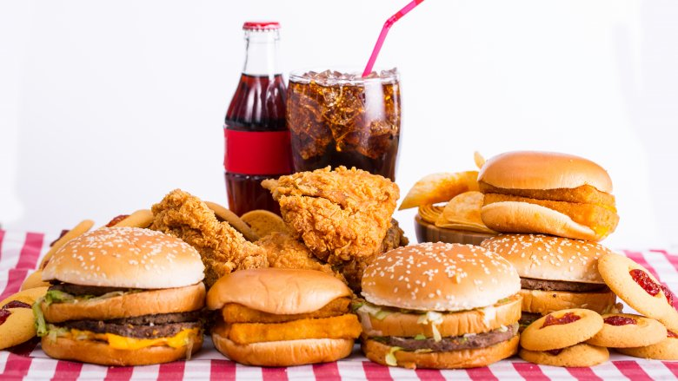
Project Plan 1.Introduction 2.Project Organization 3.Resource Requirements 5.User and System Requirement 6.System Model 7.Risk Analysis

Slide 3
Introduction Description: The proposed topic Cafeteria Management System (hereafter called “CMS”) is a computer-based system that will allow Cafeteria Administrator to create online to assist teachers or students can order section if they can’t come to cafeteria. If this software can be used to IU portal, the student will be more comfortable and happy about IU’s cafeteria service. Constraints Time: This project must be implemented by august 19, 2021 to allow time for user familiarization and training in IU. Budget: All costs associated with the project will relate to the human resources required to develop the software.

Slide 4
Resource Requirements 1. Human Resource All members of team come from International University, so we have a good basic knowledge about software process and skill in programming as well as team-work. 2. Hardware and software Resources Cafeteria Management System is created by using PHP, with functions and small database SQL, so we just need an average sever.

Slide 5
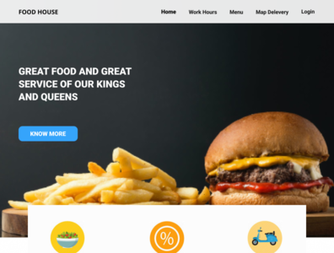
User and System Requirement User Requirement : The customer or the admin to log in their homepages. The customer register an account. The customer select the food/drink in the cafeteria shop websites. The users check out the selected product. The admin can add the new food/drink. The admin can update the information of the store. The admin can delete food/drink.The admin can view the report.

Slide 6
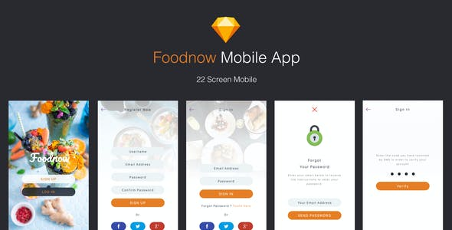
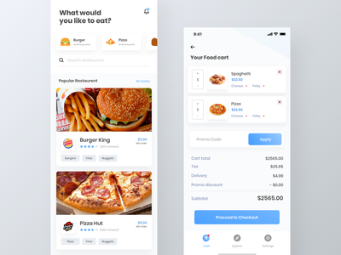
User and System Requirement Functional: Login Register Order food/Drink Checkout product Add Food/Drink Update Food/Drink information Delete Food/Drink View Report Non-Functional: Product Requirements Organization Requirements External Requirement

Slide 7
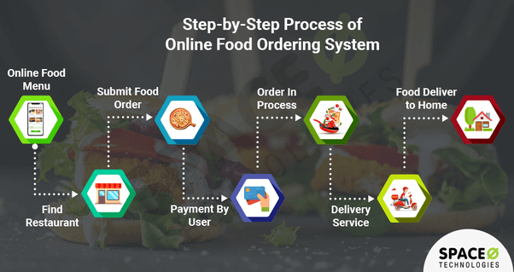
System Model

Slide 8
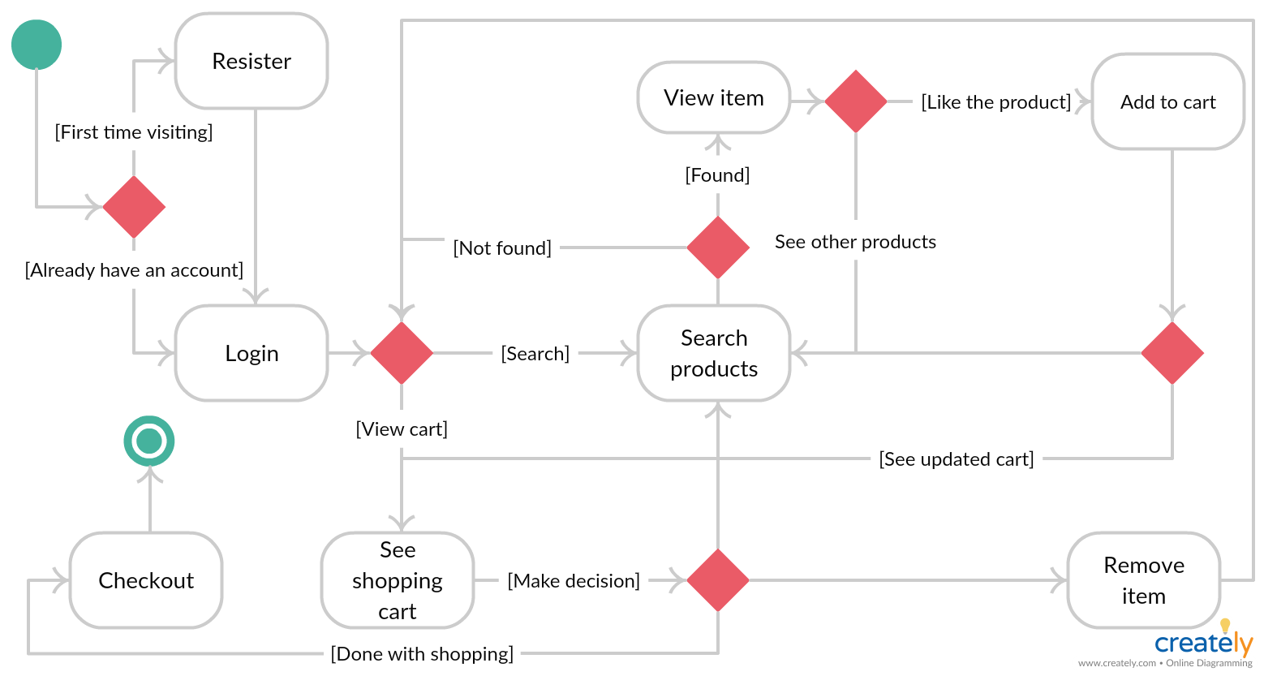
State Diagram

Slide 9
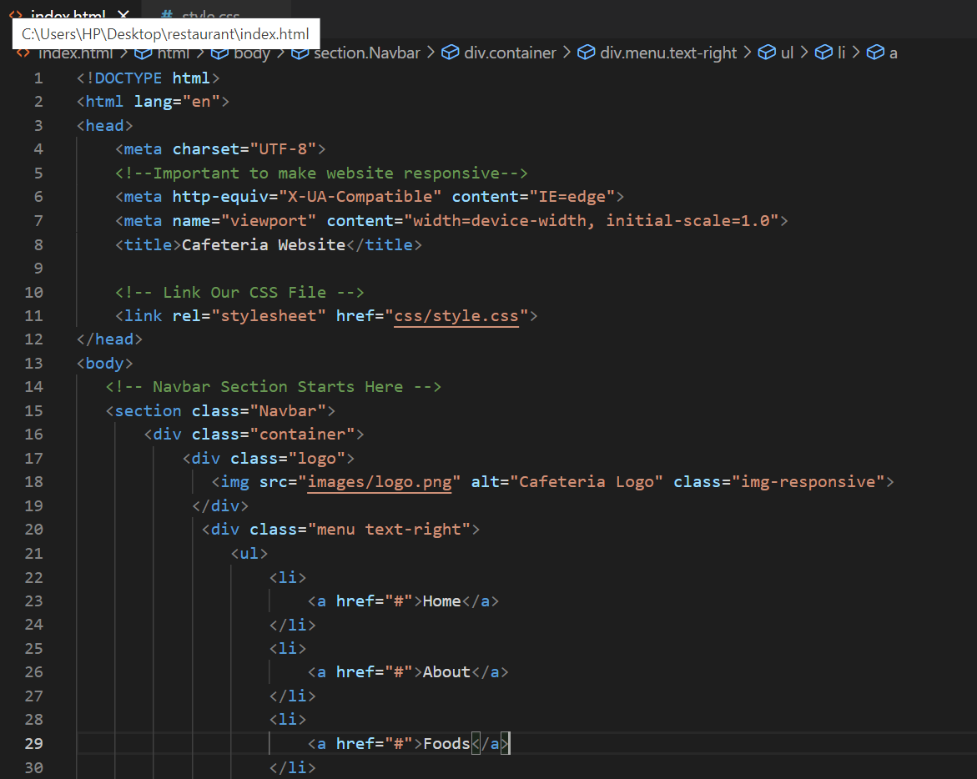
html code:

Slide 10
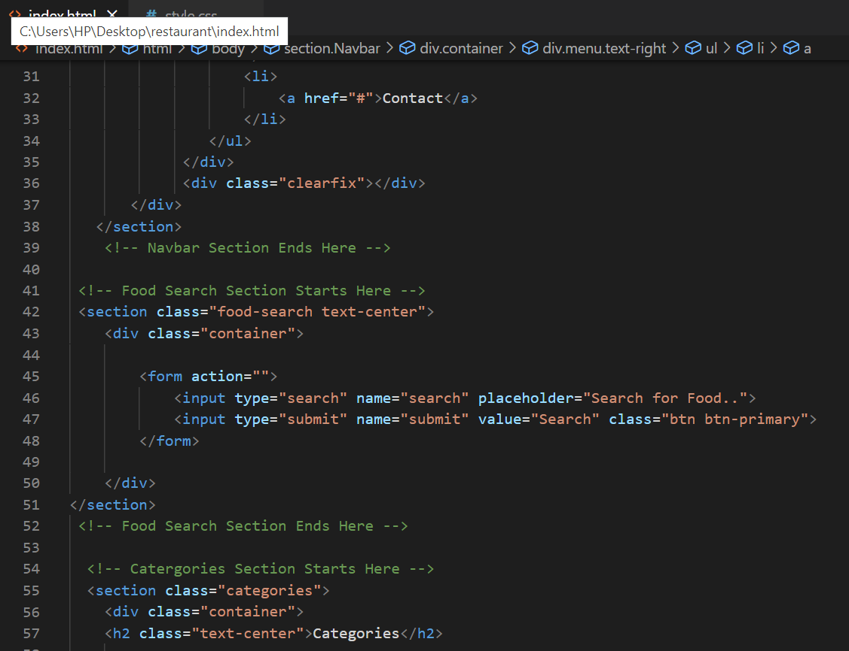

Slide 11
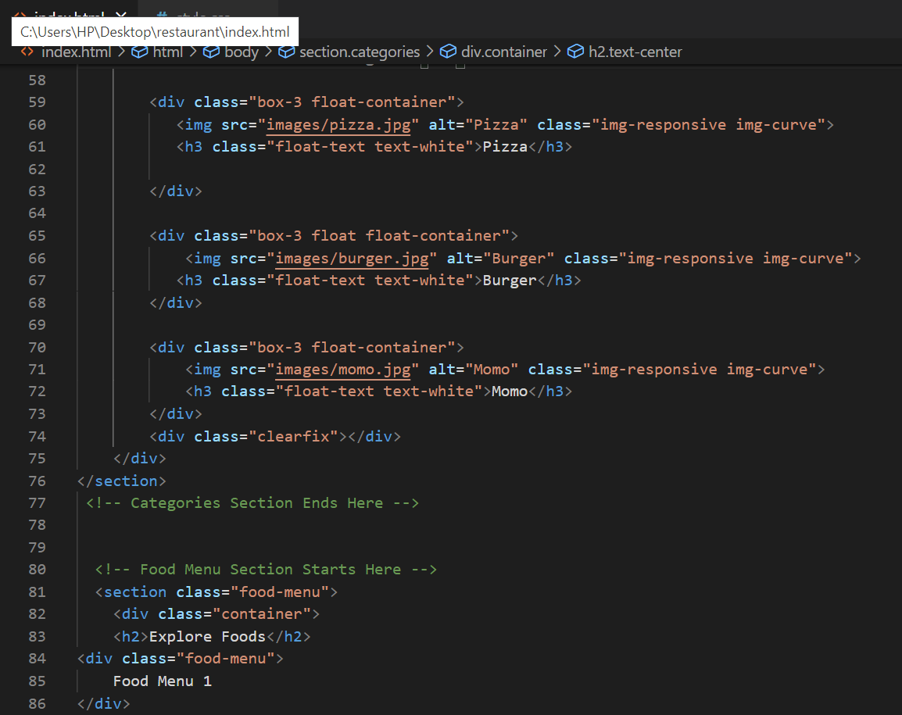

Slide 12
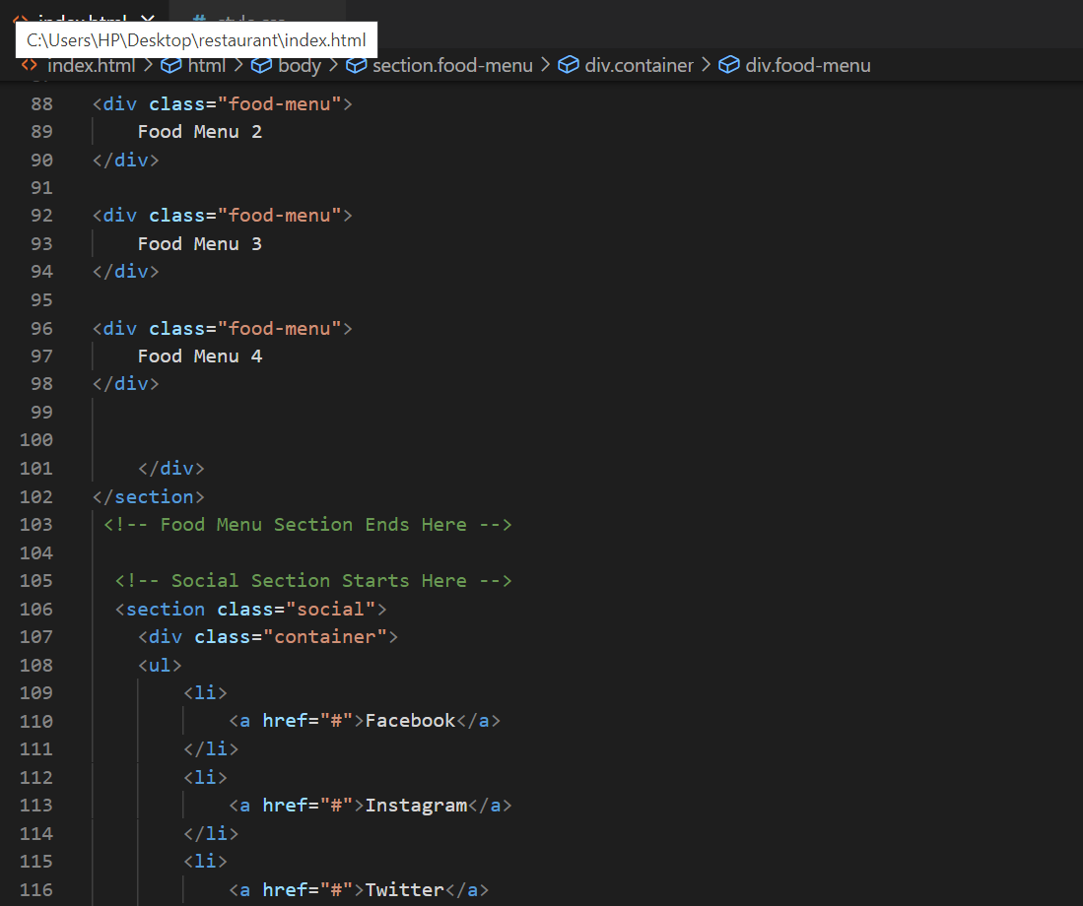

Slide 13
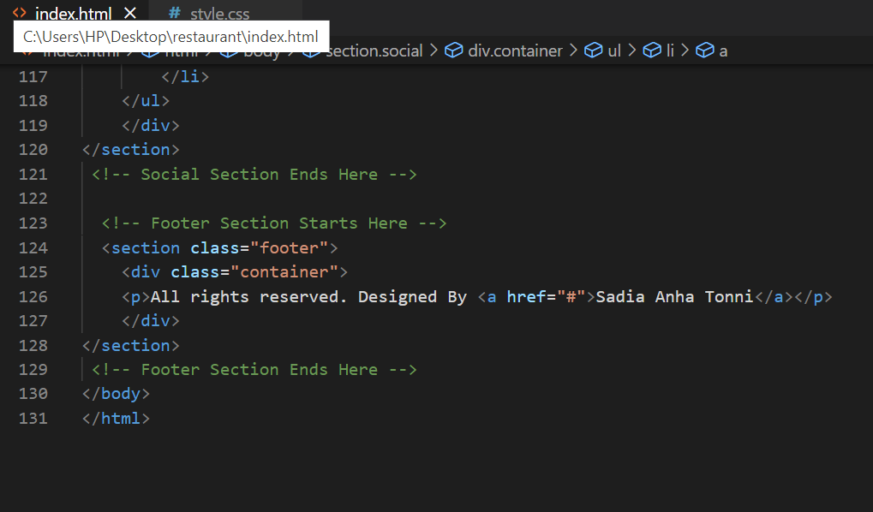

Slide 14
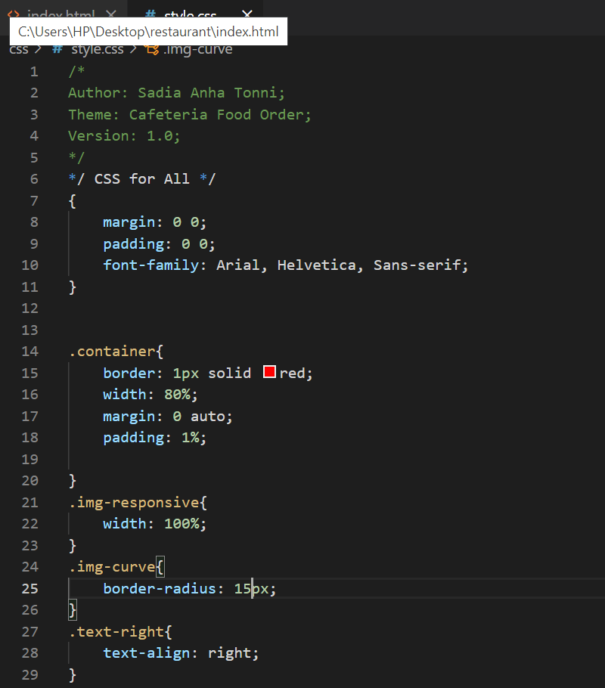
Css Code:

Slide 15
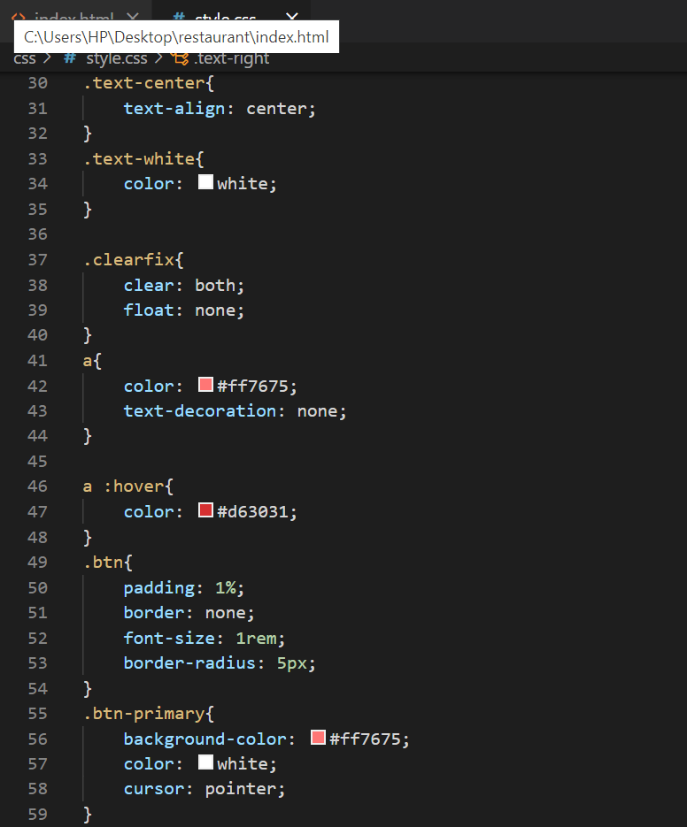

Slide 16
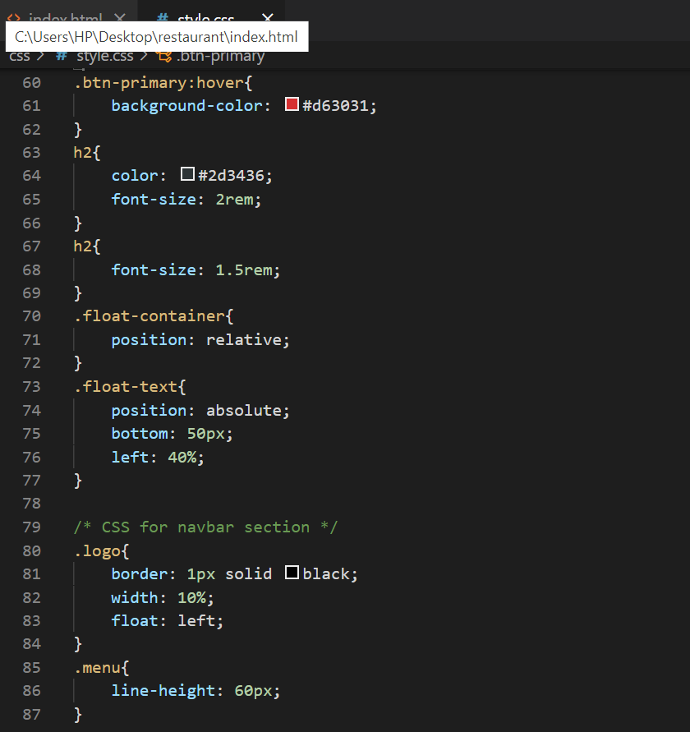

Slide 17
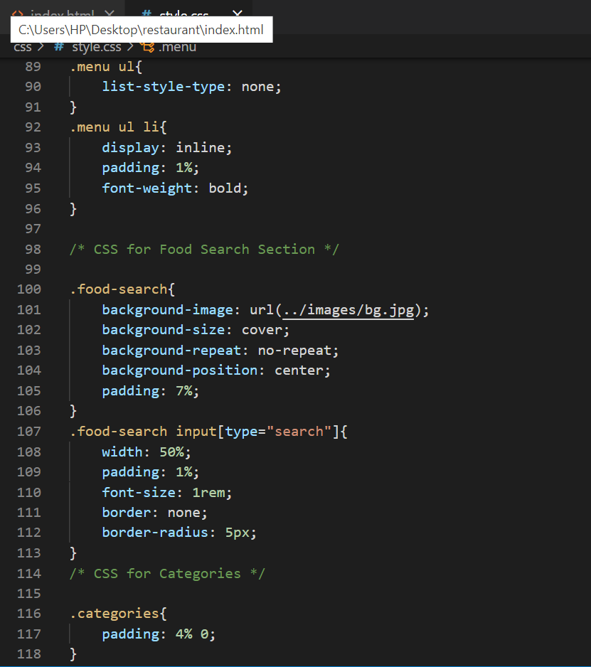

Slide 18
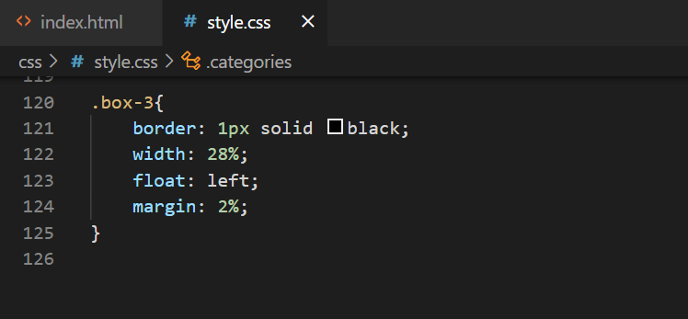

Slide 19
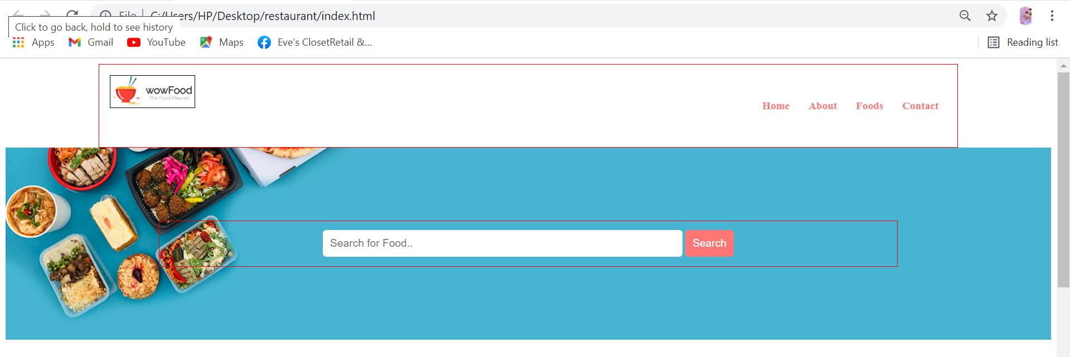
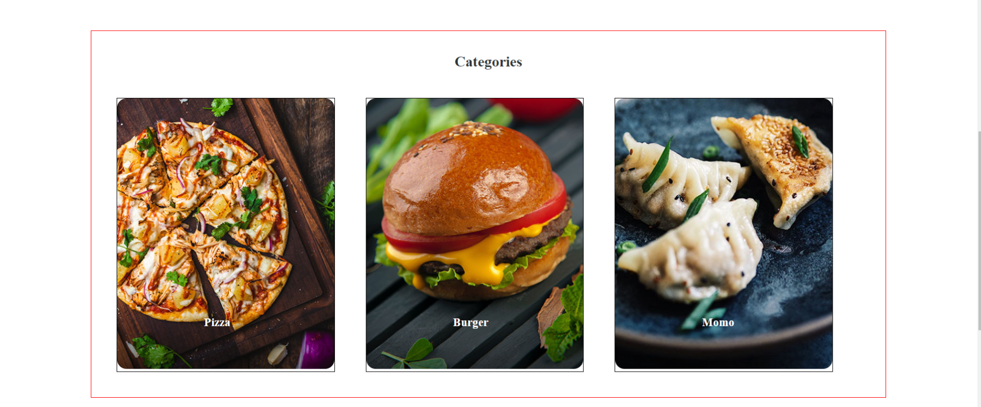
Output:

Slide 20
Thank You☺

